Slide 1


Twitter Sentiment Analysis
Done by: Team Adroit
Pankaj Kumar Rinkesh Gaikwad
Piyushak Knot Devangi Sheth

Slide 2

Problem Statement
Identifying the sentiments about the product/brand with the evaluated tweets of multiple brands expressed as positive, negative, or no emotion towards a product/brand

Slide 3
Evaluation Metric
We will be using ‘weighted’ F1-measure as the evaluation metric
The F1 score can be interpreted as a weighted average of the precision and recall, where an F1 score reaches its best value at 1 and worst score at 0.
F1 = 2 * (precision * recall) / (precision + recall

Slide 4
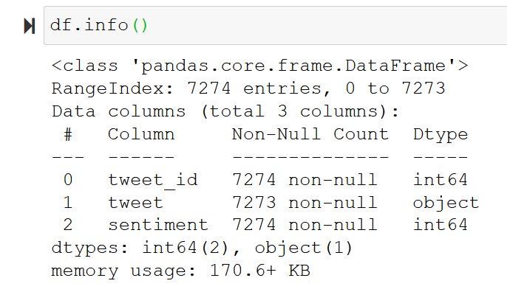
Dataset Description
This dataset contains around 7k tweet text with the sentiment label.
With 3 rows
tweet_id - Unique id for tweets. tweet - Tweet about the brand/product sentiment - 0: Negative, 1: Neutral, 2: Positive, 3: Can't Tell

Slide 5
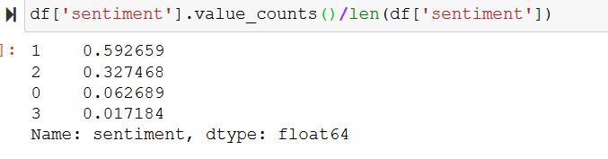
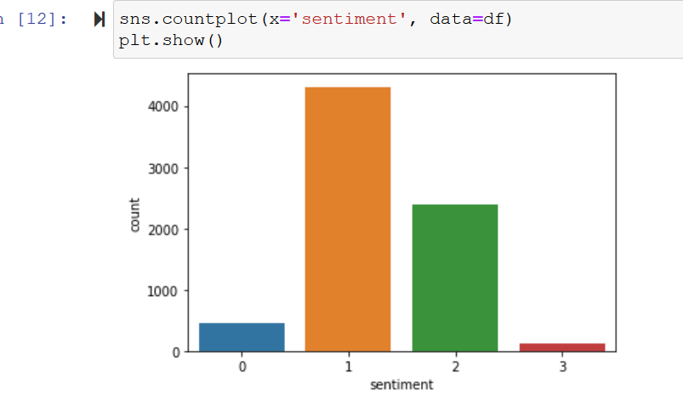
Explore the distribution of labels in the Train data

Slide 6
Data Cleaning
Null tweet row deletion
Combine train+ test data for cleaning
frequent word removal
rare word removal
remove Urls (hhtp, www)
Punctuation removal
removal of Nouns/ proper nouns using testblob
Textblob to correct spelling
removal of specific non meaningful words

Slide 7
Advance Data Processing
Converting html entities
Removing "@mention" from the tweets
Converting all the tweets to lowercase
Apostrophe conversion
Short Word conversion
Replacing Punctuations with space
Replacing Special Characters with space
Removing words of length 1
Tokenize
Stop word – stem (snowball/ porter) – lemm

Slide 8
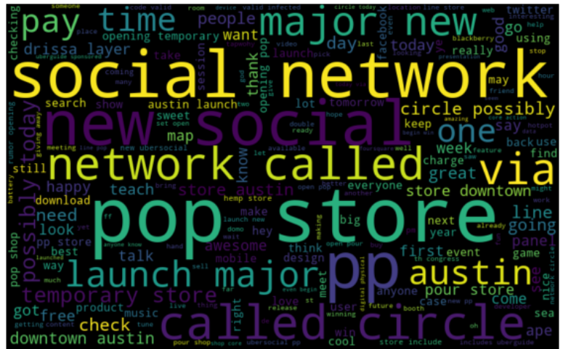
Data Visualization Wordcloud
Based on sentiments
Full Data

Slide 9
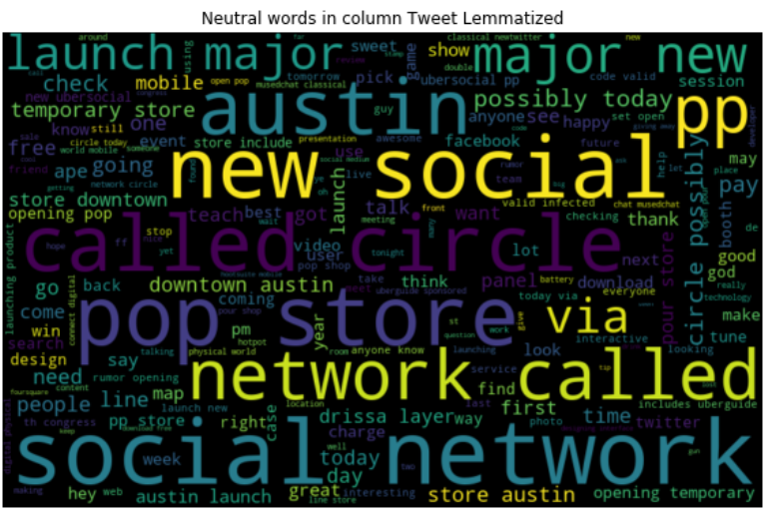
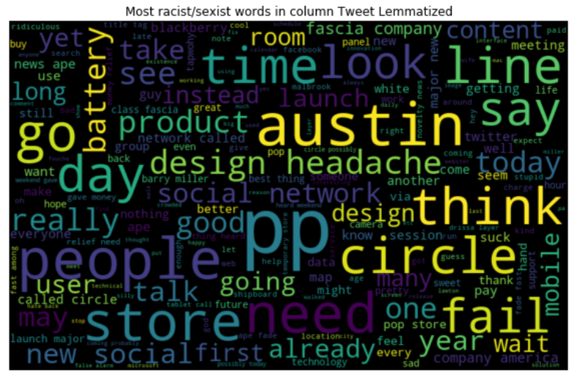
Sentiment = 0
Sentiment = 1
Negative sentiments
Fail
Wait
Headache

Slide 10
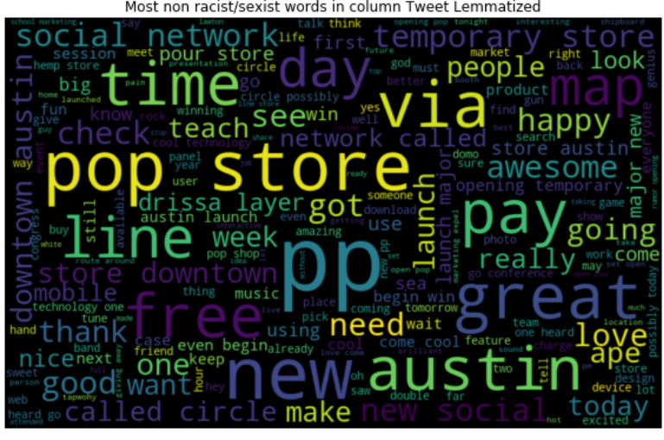
Sentiment = 2
Positive sentiments
Love
Great
Happy
Awesome
Free

Slide 11
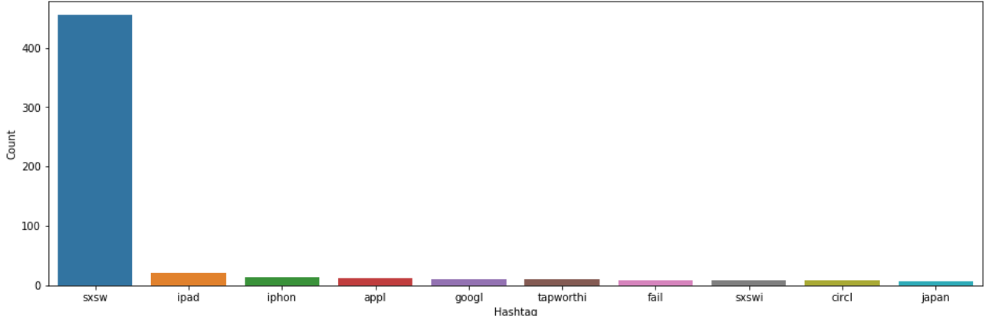
Understanding of Hashtags

Slide 12
Models and Approaches
Model | F1 Score
Logistic Regression(CV) | 0.6518
Logistic Regression(TFIDF) | 0.6388
Random Forest Classifier | 0.6636
SVM | 0.6523
Naïve Byes | 0.6412
Logistic Regression(ROS) | 0.6534
Logistic Regression(Tomek) | 0.6623
Logistic Regression(SMOTE) | 0.6481
GridSearchCV(C, penalty, CV) | 0.6518

Slide 13
Models – Unsupervised approach
Model | F1 Score
VaderSentiment | 0.5466
TextBlob | 0.5295

Slide 14
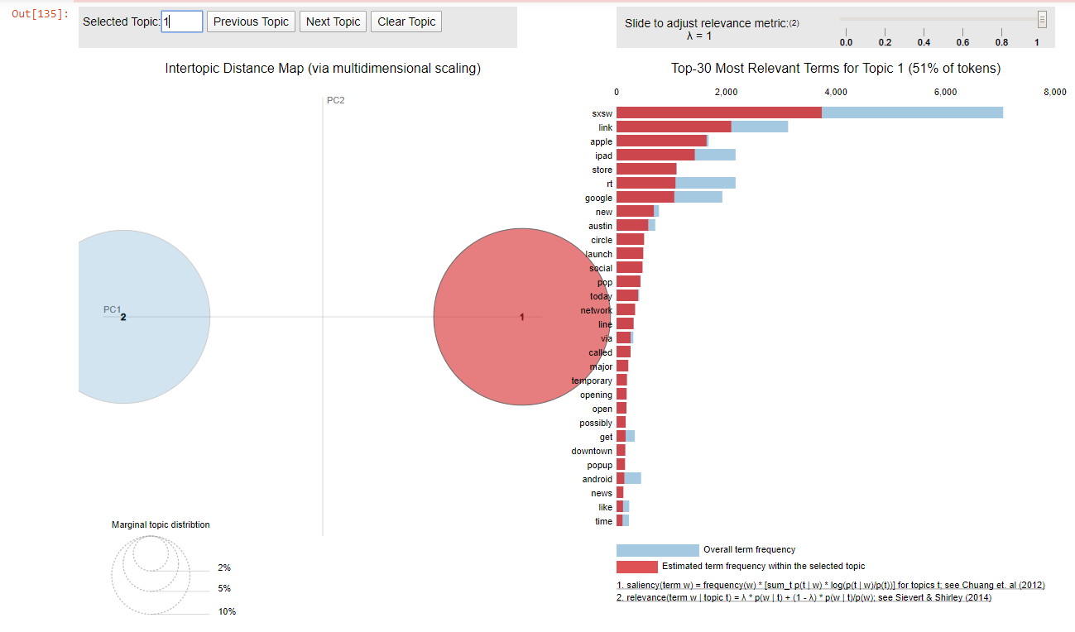
Topic Modelling
Topic 1) SXSW
2) Google
3) Apple

Slide 15
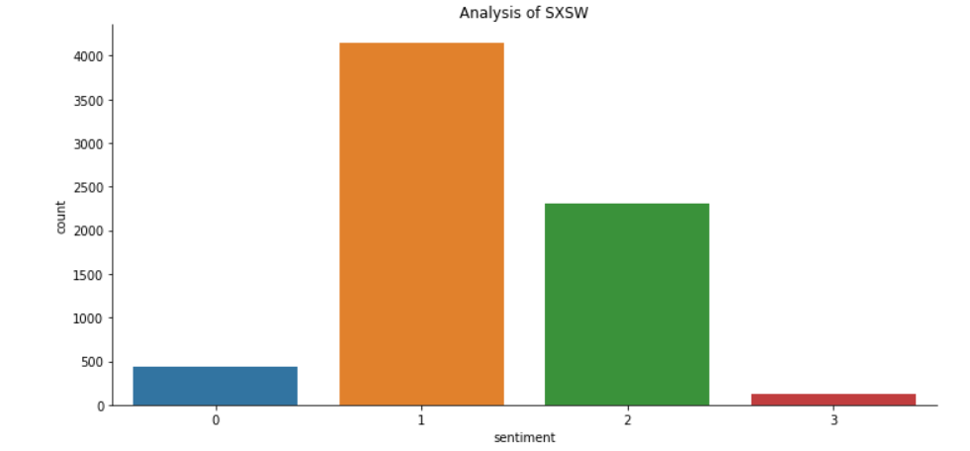
Insights

Slide 16
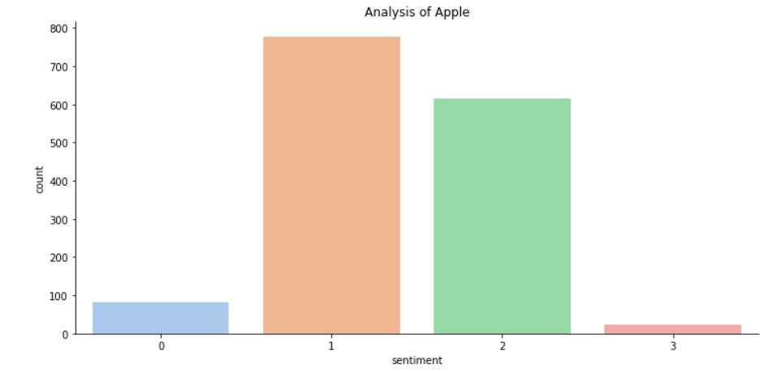
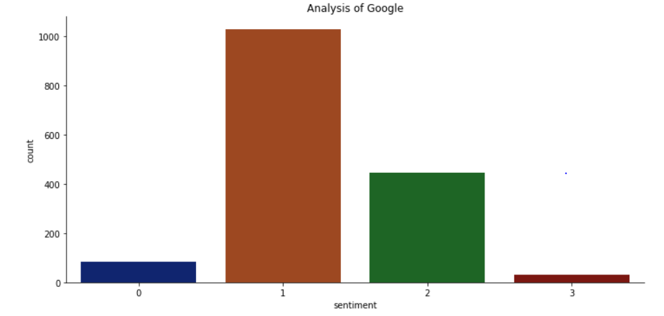
Brand analysis

Slide 17

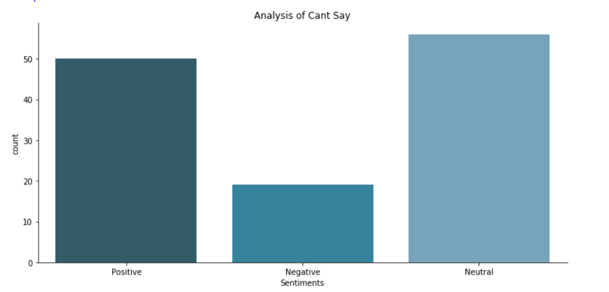
Worked withCan't say

Slide 18
References
GLAB – Sentiment analysis
Stack Overflow
https://towardsdatascience.com/twitter-sentiment-analysis-classification-using-nltk-python-fa912578614c
https://machinelearningmastery.com/clean-text-machine-learning-python/
https://www.kaggle.com/sudalairajkumar/getting-started-with-text-preprocessing
https://www.kaggle.com/saishan/nltk-naivebayes-sentiment-analysis
https://ryan-cranfill.github.io/sentiment-pipeline-sklearn-5/
https://www.researchgate.net/publication/312590328_Utilizing_Hashtags_for_Sentiment_Analysis_of_Tweets_in_The_Political_Domain
https://www.kaggle.com/lbronchal/sentiment-analysis-with-svm

